Slide 1


Road Sign and Road State Notification App (SafeWaka)
Task 5 : UI Design and Implementation
By Group 4

Slide 2
Introduction
SafeWaka is a comprehensive mobile application that empowers drivers with real-time information about road signs, traffic, and weather conditions, enabling safer and more efficient journeys.

Slide 3
UI Design Principles
Intuitive Navigation
Responsive Design
Data Visualization
The UI prioritizes a smooth, intuitive user experience, with clear and logical navigation that minimizes cognitive load.
The app adapts seamlessly to various screen sizes and device orientations, ensuring a consistent and accessible interface.
Intelligent data visualization techniques are employed to present complex road and traffic information in a clear and concise manner.

Slide 4
Key Features of UI
1
Real-Time Road Updates
2
Customizable Alerts
Timely notifications about road signs, construction, accidents, and weather conditions to help drivers make informed decisions.
Users can personalize alert preferences based on their driving routes and preferences, ensuring relevant information.
3
Voice Commands
4
Integrated Maps
Hands-free voice control allows for easy access to key features and minimizes distractions while driving.
Detailed maps with turn-by-turn navigation provide context and guidance for the road conditions.

Slide 5
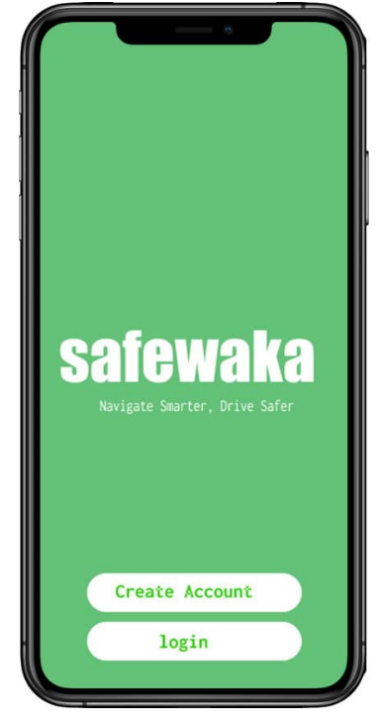
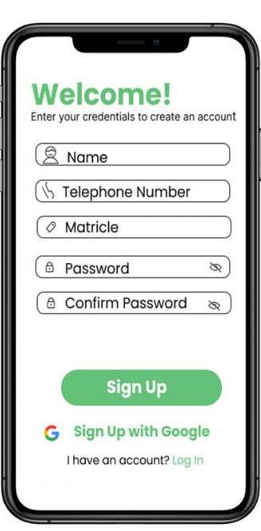
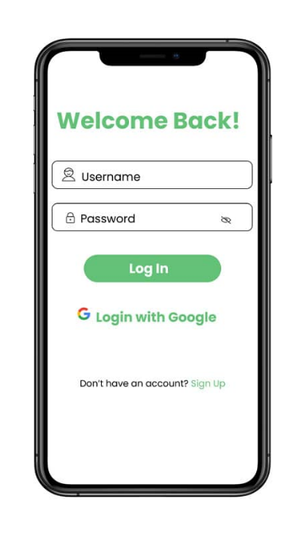
User Interface Wireframes and Mockups
Landing Page
Sign up
Sign in
To allow a driver and other actors to enter their credential to create an account
Allows the user of the account to access back resources
To allow the user to sign up he does not have an account and to login it otherwise

Slide 6
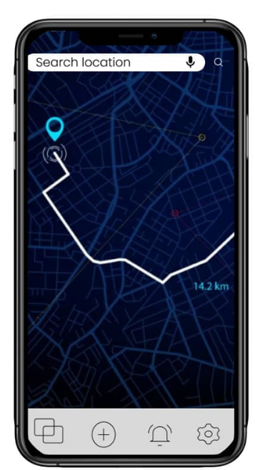
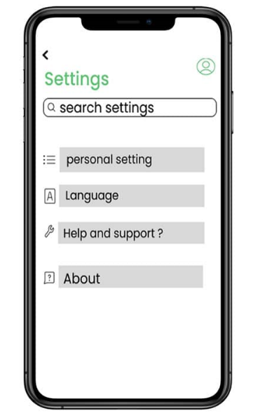
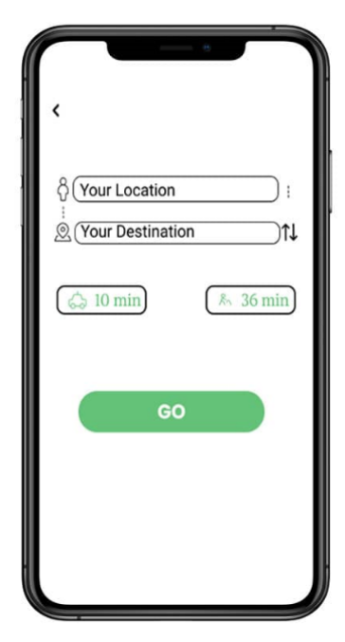
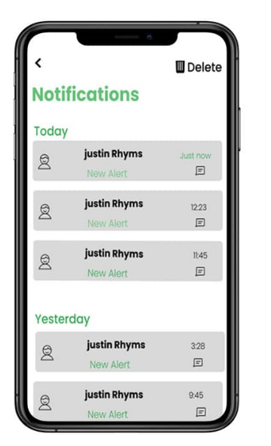
User Interface Wireframes and Mockups
Main Screen
Settings Menu
Explore
Notifications
To receive alerts on road sign ,state and other alerts such as accidents
The app's main screen provides an overview of the current road conditions and allows users to navigate the key features.
Users can personalize their experience by adjusting alert preferences and other settings in the dedicated settings menu.
The driver can be localized on the map input its destination a navigate through the best path based on its location

Slide 7
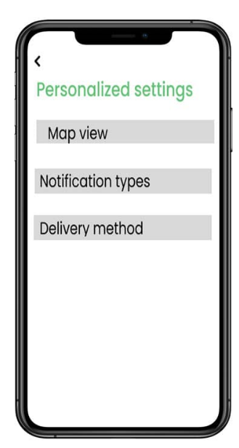
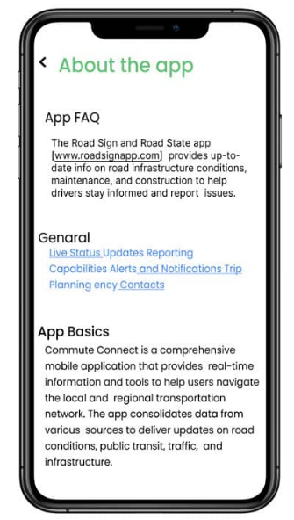
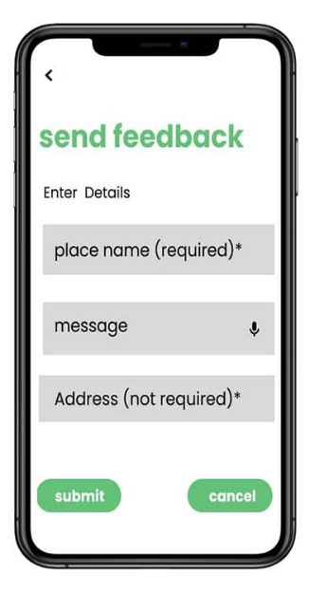
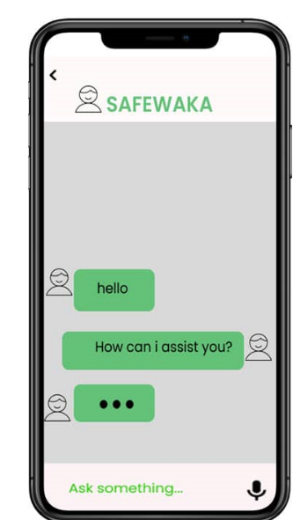
User Interface Wireframes and Mockups
Personalized setting
About the app
Send Feedback
Chat bot
To report issues related to the app to acquire assistance
Personalize your settings to meet your needs such the types of notification we want to receive the delivery method and the area .
Provides all the information on the working principle of the application
Allows the app user to send feedback on road sign,state and other alerts which is first approved by the admin and then viewed by other users

Slide 8
Design Specification
Font Family
The primary font family is Poppins
Color
The primary color is bright green #64C178
The accent color is white #FFFFFF
The second primary color is gray

Slide 9




Typography and Iconography
Road Signs
Weather Conditions
Traffic Status
Alerts
Clear and recognizable icons for various road signs, enabling quick identification of important information.
Easily distinguishable icons for different traffic conditions, such as congestion, accidents, and construction.
Attention-grabbing alert icons that inform drivers of important notifications and updates.
Intuitive weather icons that convey current and forecasted weather conditions at a glance.

Slide 10



Responsive Design and Accessibility Considerations
Adaptive Layout
The UI adapts seamlessly to various screen sizes and device orientations, ensuring a consistent and accessible experience.
Accessible Features
The app includes features like high-contrast mode, adjustable text size, and voice control to cater to users with diverse needs.
Inclusive Design
The UI is designed with inclusivity in mind, prioritizing simplicity, clarity, and ease of use for all users.

Slide 11

Implementation
Prototype Development
1
The team creates interactive prototypes to validate the UI design and gather user feedback.
2
Iterative Refinement
Based on user testing and feedback, the UI is continuously refined and improved to ensure a seamless experience.
Accessibility Testing
3
Comprehensive accessibility testing is conducted to ensure the app meets the highest standards of inclusivity.

Slide 12
Conclusion
Empowering Drivers
Seamless User Experience
The SafeWaka app empowers drivers with real-time information, enabling safer and more efficient journeys.
The intuitive UI, responsive design, and accessible features ensure a seamless and inclusive experience for all users.
Continuous Improvement
Transformative Impact
The app's development process is characterized by iterative refinement and a commitment to delivering the best possible product.
SafeWaka has the potential to revolutionize the way drivers navigate and interact with road conditions, making a significant impact on road safety.

Slide 13
THANKS FOR LISTENING

